Slide 1
Creative Student Collaboration
Presented by
Sarah Ashley, Instructional Technology Specialist
Gamin Bartle, Director, Instructional Technology Services
SUNY Delhi Moodle Moot 2011 | May 24, 2011

Slide 2
Part 1: Sarah Ashley
Use of the Database Activity in a Biology Course Diversity of Life: Animals, Plants & Microbes

Slide 3
Course & Project Description
Project Implementation
Format #1: MS FrontPage web pages
Sample pages & Problems
Format #2: Moodle web pages
Sample pages & Problems
Format #3 (current) & Sample pages
Under the Hood
Creating the database fields
Setting up the templates
Pre-loading the entries

Slide 4
COURSE & Project Description
Research assigned organism
Share findings via a web page
Perform peer-reviews
Refine web page based on peer-review
Add information to Biome Group web page
Notes:
Dr. David Miyamoto teaches one section of the Diversity of Life biology course and as part of the curriculum requires students to develop research skills.
To facilitate this, he developed a research project where each student is assigned an organism to research based on given guidelines and parameters.
Students then share their research by publishing their findings on a web page. They each perform and receive anonymous peer-reviews of the organism web pages, and based on the feedback, refine their web pages.
The final product is incorporated into a group web page that contains information about all the organisms that belong in that same Biome or Habitat.

Slide 5
MS FrontPage Web Pages
IMPLEMENTATION #1

Slide 6
Implementation #1
Microsoft FrontPage
Microsoft FrontPage
Research the assigned organism
Share findings via a web page
Perform peer-reviews
Refine web page based on peer-review
Add info to Biome Group web page
Handwritten Paper
Reviews
Notes:
Initial implementation was to create web pages using Microsoft FrontPage. A template was developed by Instructional Technology Services and students were trained on how to build their pages from the template.

Slide 7
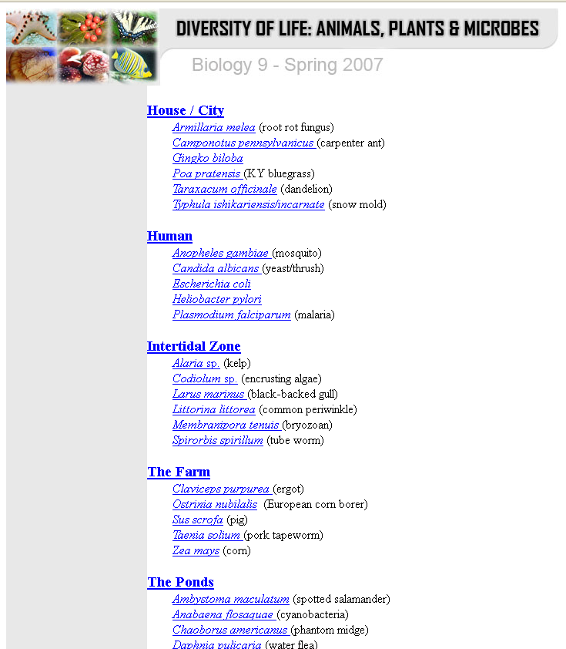
FORMAT #1 MS FrontPage Website
Landing page:
Index/Directory of all Organisms grouped by Biome
Link to each Organism’s web page

Slide 8
FORMAT #1: MS FrontPage Web Page Sample
Notes:
Students designed pages that looked like this…

Slide 9
FORMAT #1: MS FrontPage Web Page Sample
Notes:
And like this…

Slide 10
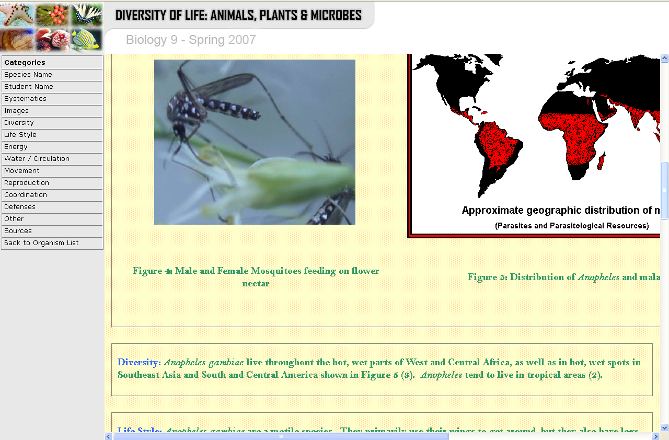
FORMAT #1: MS FrontPage Web Page Sample
Notes:
And also like this…
Problems with inconsistent image sizes and tendency to break table layout of web page.
Horizontal scrolling.

Slide 11
Problems
Time-consuming
Inconsistent
Software access
Notes:
Time taken away from research and project content to focus on technical skills and support for building the web page.
Pages were getting aesthetically and structurally inconsistent.
The University no longer supported the software so students no longer had access to Microsoft FrontPage.

Slide 12
Moodle Web Pages
IMPLEMENTATION #2

Slide 13
Implementation #2
Moodle Web Pages
Moodle Web Pages
Research the assigned organism
Share findings via a web page
Perform peer-reviews
Refine web page based on peer-review
Add info to Biome Group web page
Handwritten Paper
Reviews
Notes:
Enter…Moodle 1.8.3
We were in our advanced pilot and had minimal expertise on the various features so went with the easiest to set up: web pages.
Tried Workshop module for Peer Review but it was faulty so they continued to submit paper peer-reviews.

Slide 14
FORMAT #2 Moodle Web pages
Whole Course
Index/Directory of all Organisms grouped by Biome
Link to each Organism’s web page
Notes:
Maintained the structure and look of the FrontPage predecessor.
Dedicated a whole course to the project.
One topic block per Biome/Habitat.

Slide 15
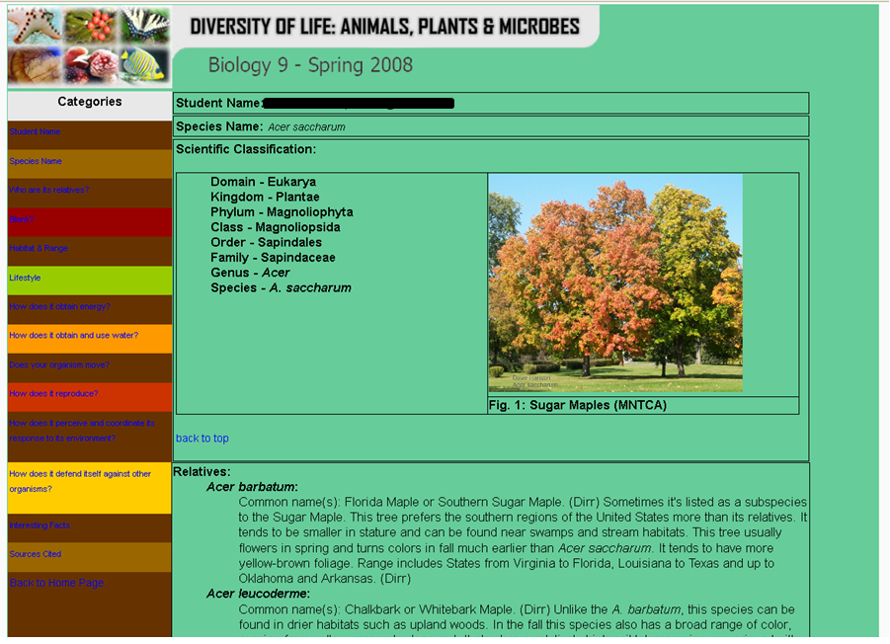
FORMAT #2: Moodle Web page Sample

Slide 16
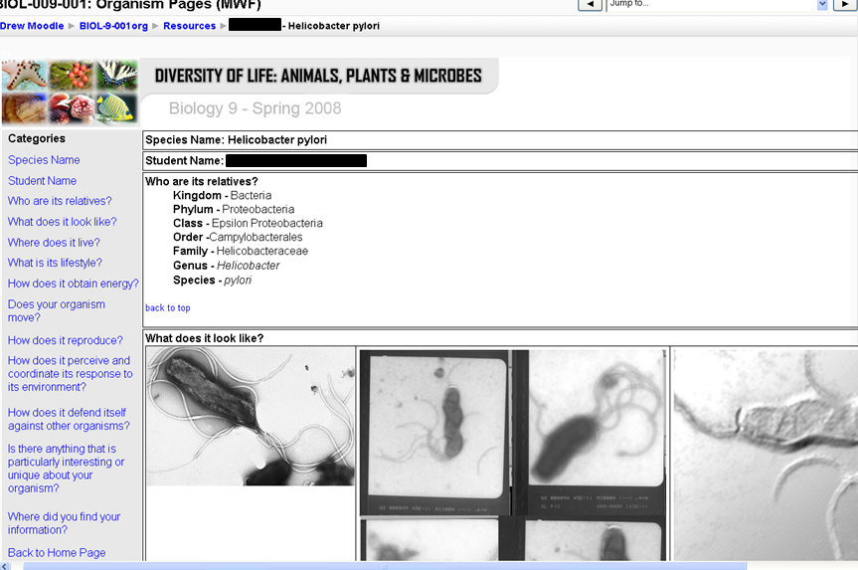
FORMAT #2: Moodle Web page Sample
Notes:
Similar problems with image sizes and HTML tables copied and pasted from Word or internet that broke the layout of the templates.

Slide 17
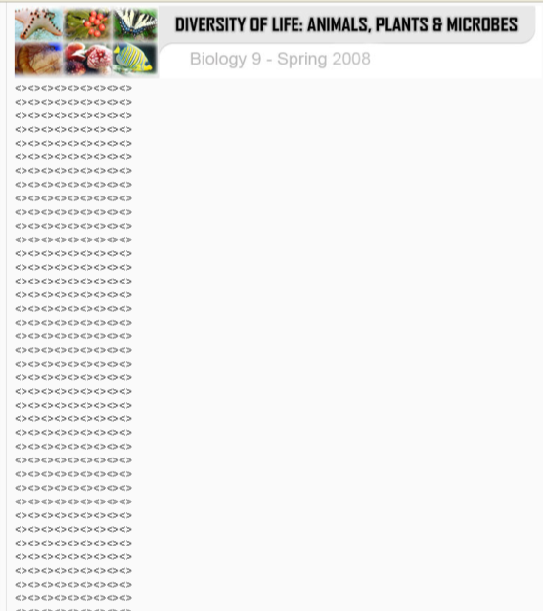
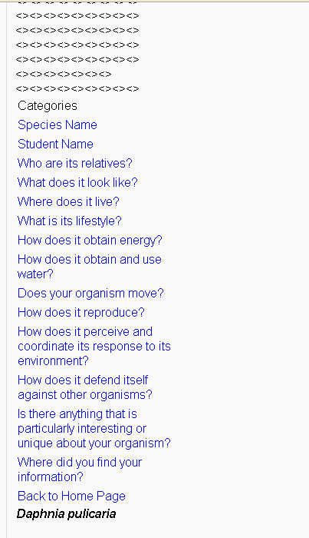
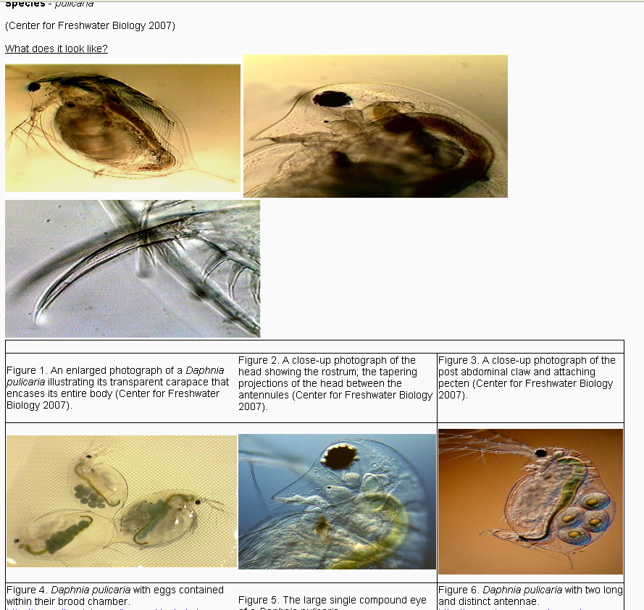
FORMAT #2: Moodle Web page Sample
broken tables!
Notes:
Even worse, students would inadvertently delete parts of the template causing major problems such as this.

Slide 18
Moodle Databases
IMPLEMENTATION #3

Slide 19
Current Moodle Implementation
Database Activity
Database Activity
Research the assigned organism
Share findings via a web page
Perform two peer-reviews
Refine web page based on review
Add info to Biome Group web page
Questionnaire
Activity
Notes:
Back to the drawing board, by the next iteration of the course, we had learned to use the Database activity and that worked perfectly.
Completed 3rd year of using the Database Activity.
Now also brought the Peer Review into digital age via Questionnaires that send email copies of the reviews to the author of the web page.
Entire system is easy to replicate each year the course is taught.
Currently on Moodle 1.9.9.

Slide 20
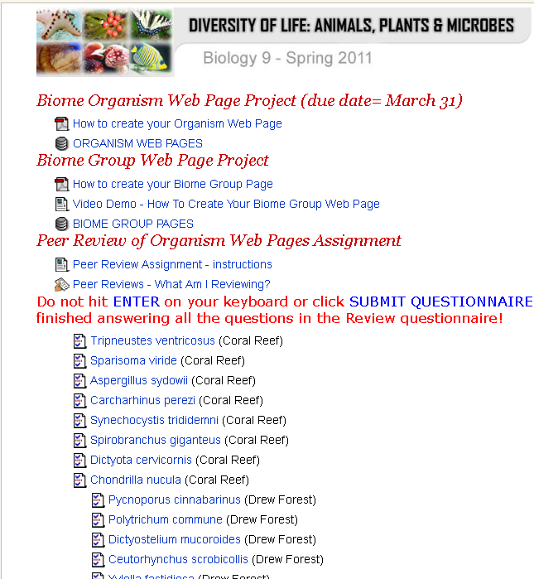
FORMAT #3 Moodle Databases
Dedicated Block
containing all resources for the project
+
Text Instructions
Video Tutorial
Notes:
A dedicated block in the Moodle Course houses all the resources and information for the project.

Slide 21
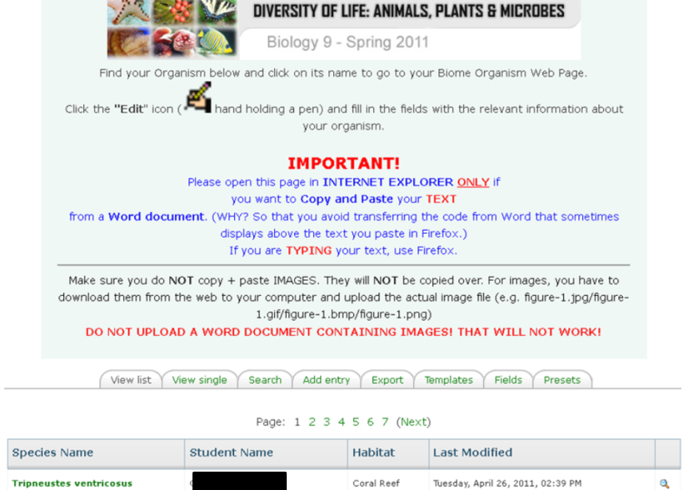
FORMAT #3: Moodle Databases

Slide 22
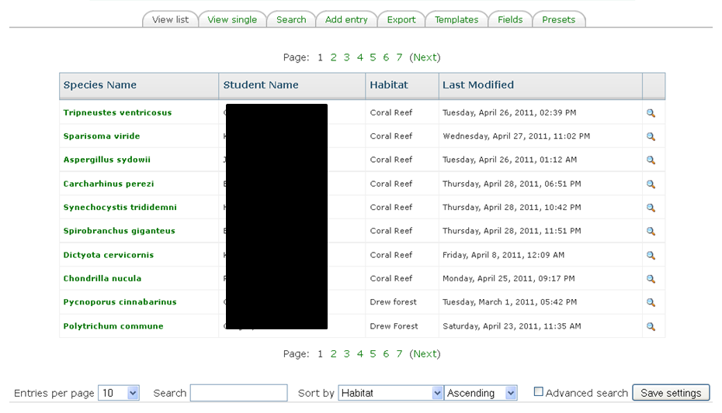
FORMAT #3: Moodle Databases List View

Slide 23
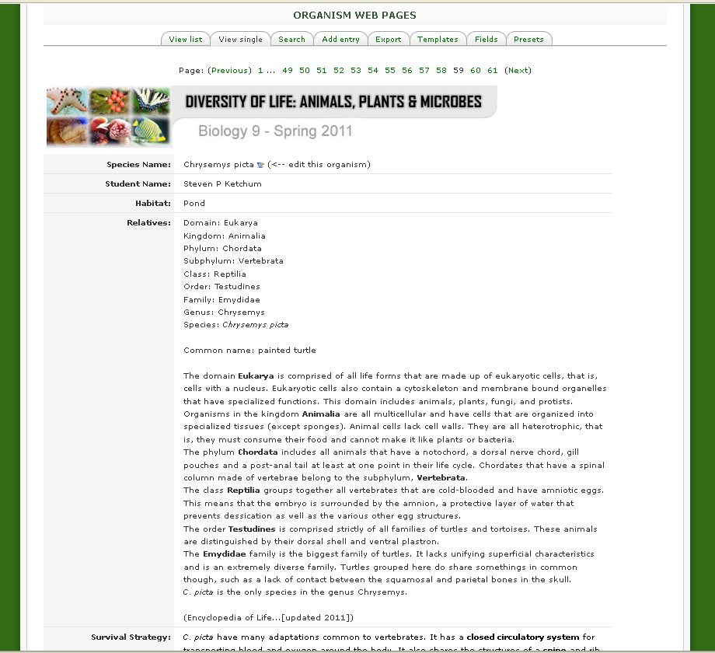
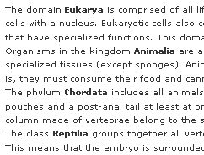
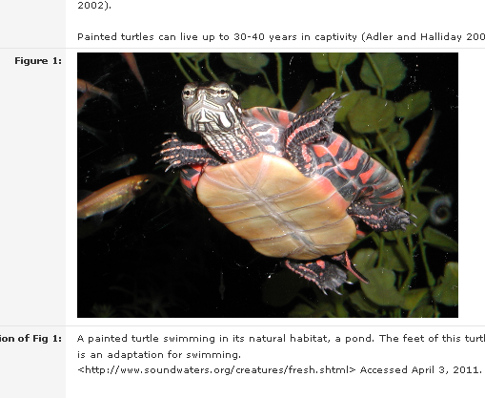
FORMAT #3: Moodle Databases Single View
More Control
over elements on the page

Slide 24
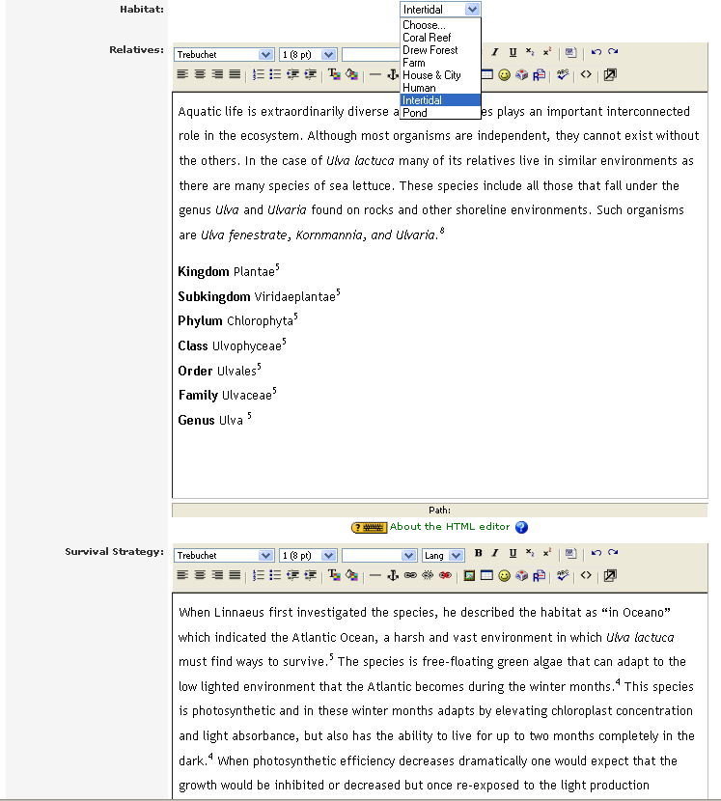
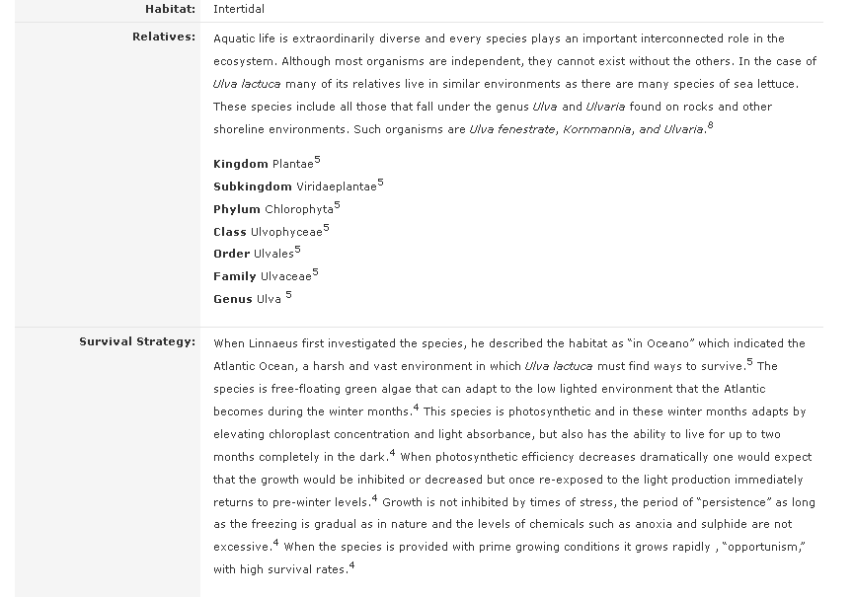
Edit Mode
1 piece of info at a time

Slide 25
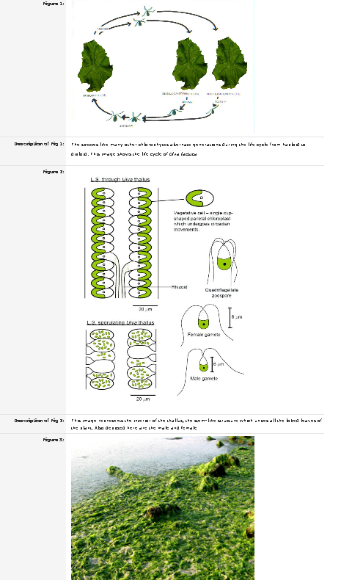
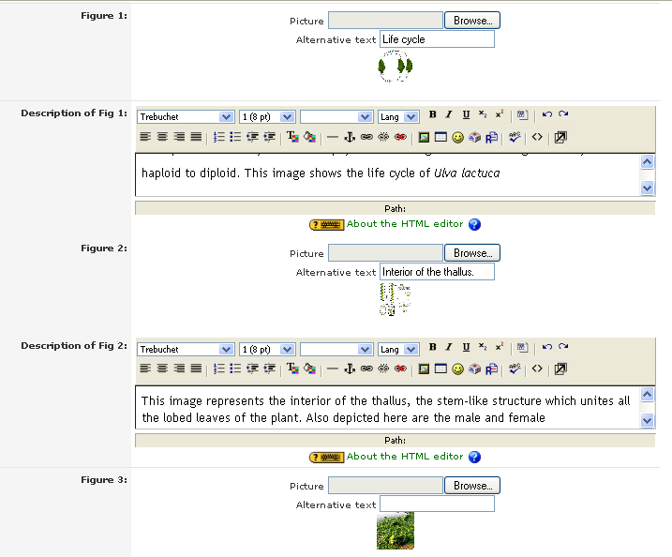
Easy image upload
Students need not worry about image dimensions or placement

Slide 26
© Arne9001 | Dreamstime.com
…a peek under the hood…

Slide 27
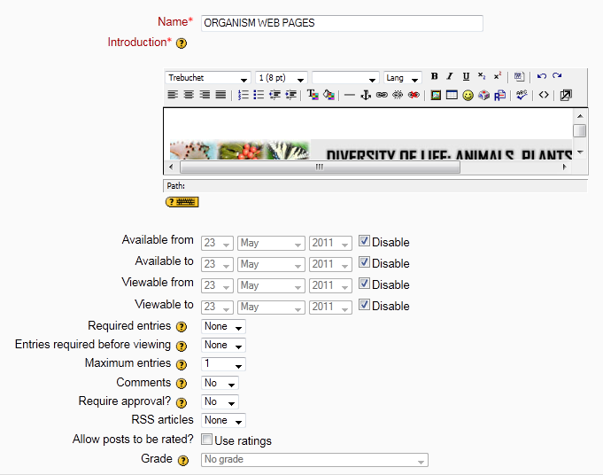
Create the database (Add an activity > Database)
Set up the basic options of the Database. When to start, due date, when to be able to view other entries.
Notes:
Set Maximum entries = 1 because all the entries will be pre-loaded and we don’t want students to Add new entries.

Slide 28
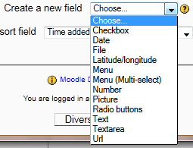
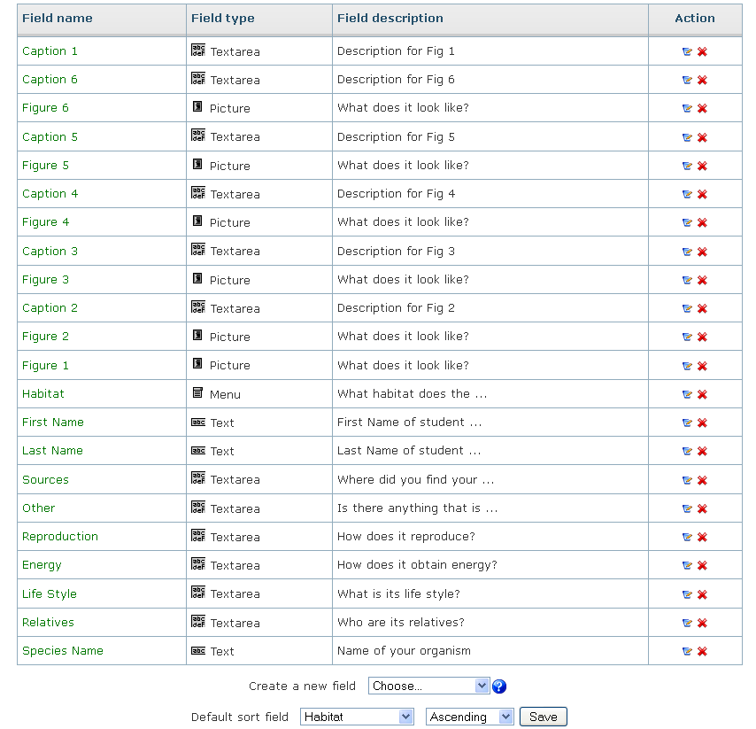
Add your database fields
Fields tab
Create new field
Enter desired settings and Save

Slide 29
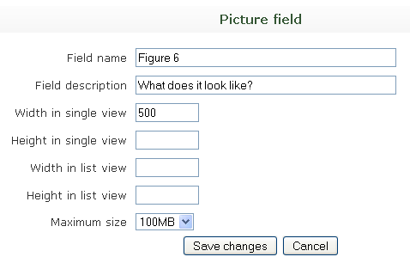
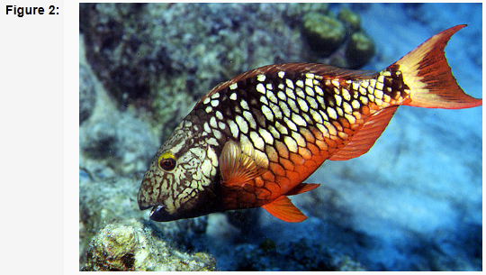
Picture field

Slide 30
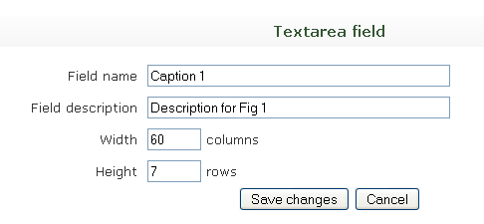
Textarea field

Slide 31
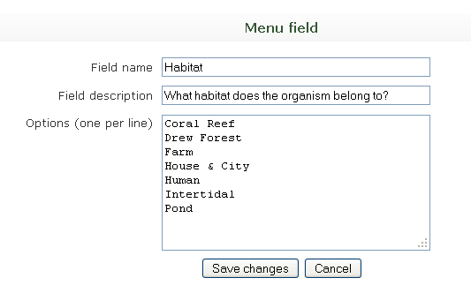
Drop-down menu field

Slide 32
Set Up Your Templates
…a peek under the hood…

Slide 33
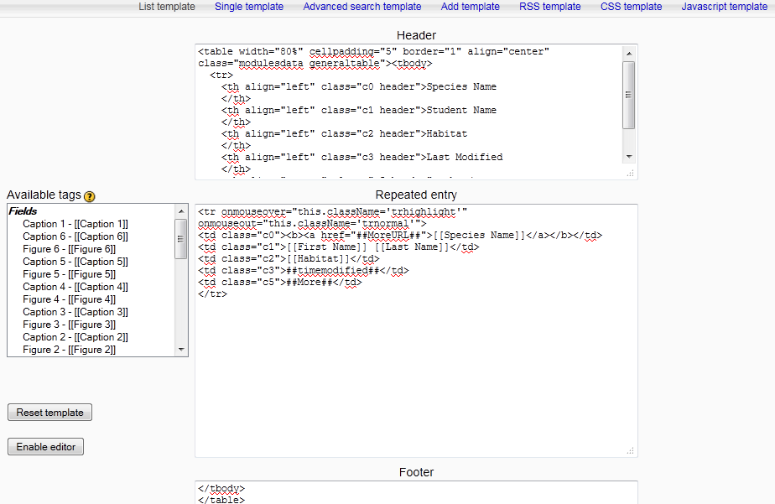
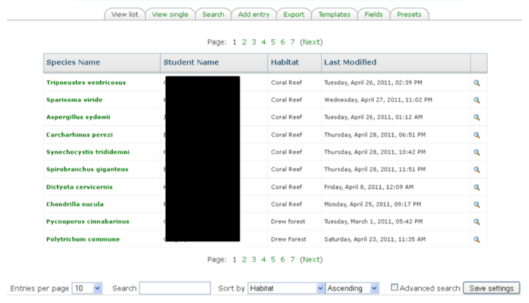
The Templates: List View Template

Slide 34
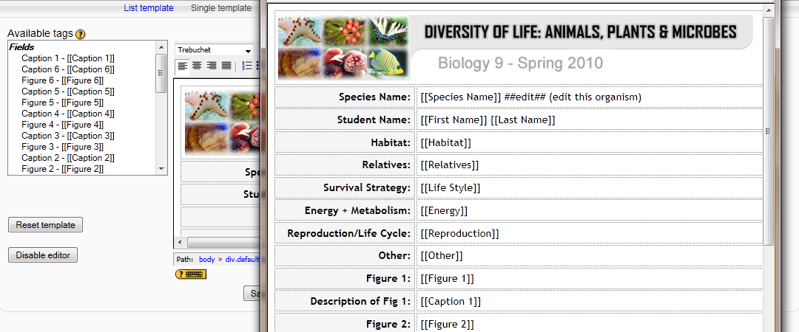
The Templates: Single View Template
Select fields you want to display on Single View page
Table for layout
Course banner
Click field on left to insert
into the template on right

Slide 35
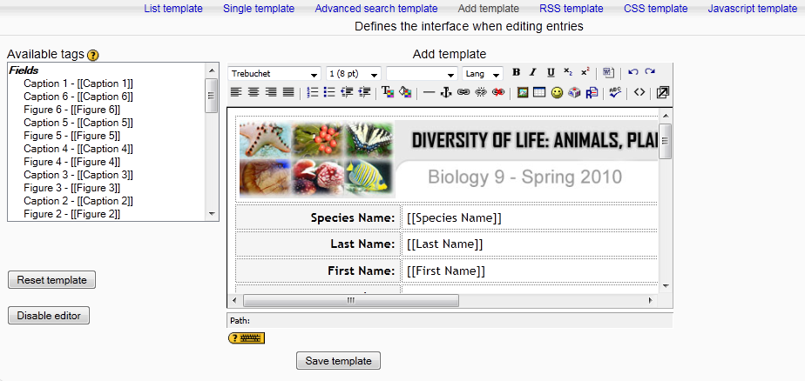
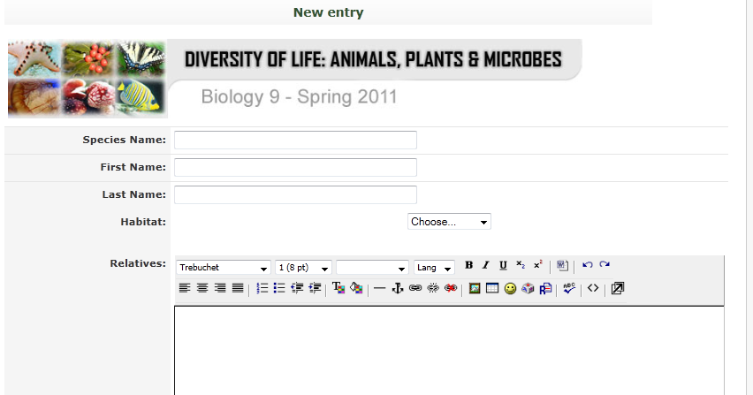
The Templates: Add Template
Select fields you want users to see when adding info to database

Slide 36
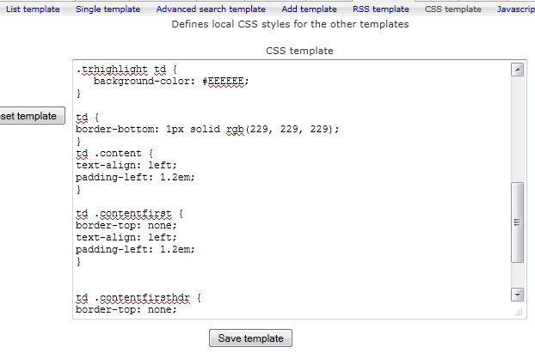
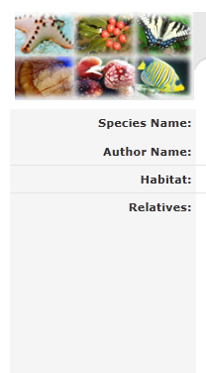
The Templates: CSS Template
Use CSS to control the look and feel of parts of the template

Slide 37
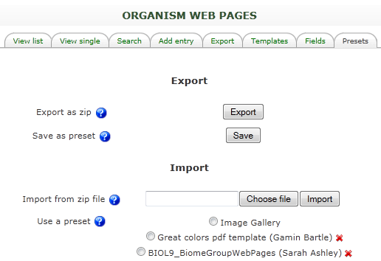
Export database as ZIP file or as PRESET for REUSE
Export as ZIP file to use on another Moodle site
Use presets on same Moodle site

Slide 38
Image Sources
Slide #8
“time consuming” – http://djscottshirley.wordpress.com
“inconsistent” – http://keytoann.files.wordpress.com/2010/10/inconsistent-red.jpg
“software access” – http://www.seomoz.org/images/post_images/no-access.gif
Slide #21
“man buying car from salesperson” – © Arne9001 | Dreamstime.com

Slide 39
PART 2: Gamin Bartle
Use of the Glossary Activity in Contemporary Feminist Theory course

Slide 40
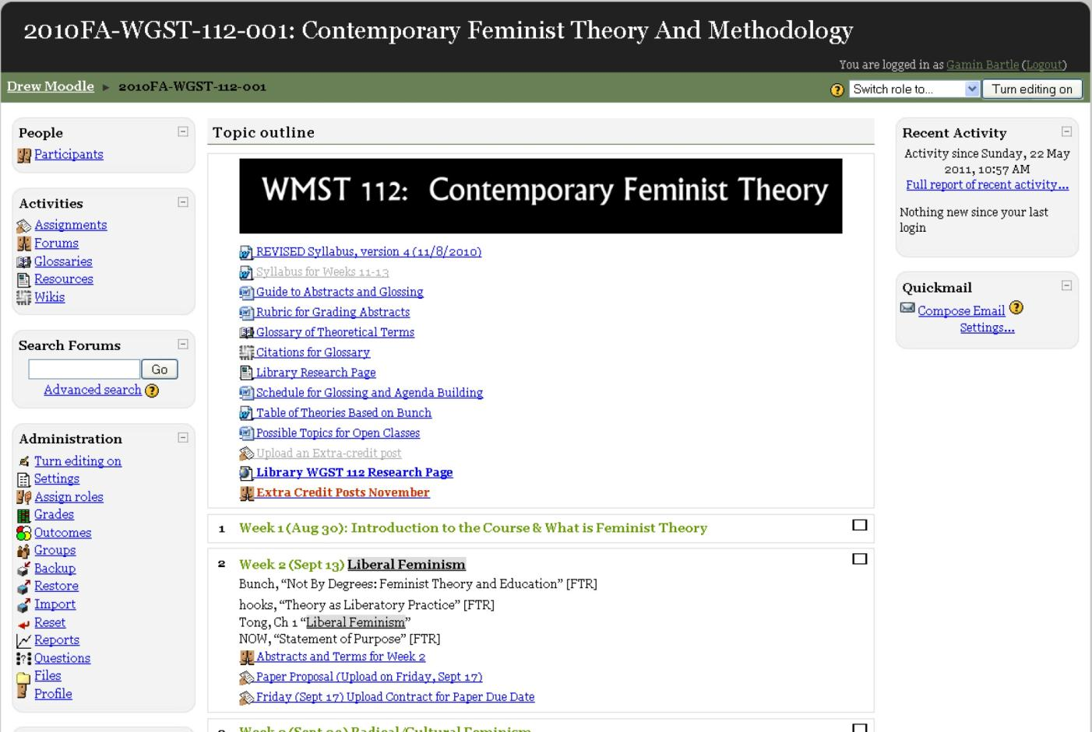

Slide 41
Outline - Use of the Glossary Activity in Contemporary Feminist Theory
Adding a glossary activity in Moodle 1.9.9
Why the glossary is so important for this course
Course Objective
Guidelines and process
Sample entries
First Step: Moodle Forum
Wiki for Citations
Web Glossary (time permitting)

Slide 42
Adding a Glossary activity (Moodle version 1.9.9)

Slide 43
Why the glossary is so important
In “Contemporary Feminist Theory,” the Moodle glossary is used as an interactive foundation for the course, both in the current and subsequent semesters.
Professor Wendy Kolmar uses the glossary as an active and collaborative tool to show her students how they should build definitions on top of their predecessors definitions over time.

Slide 44
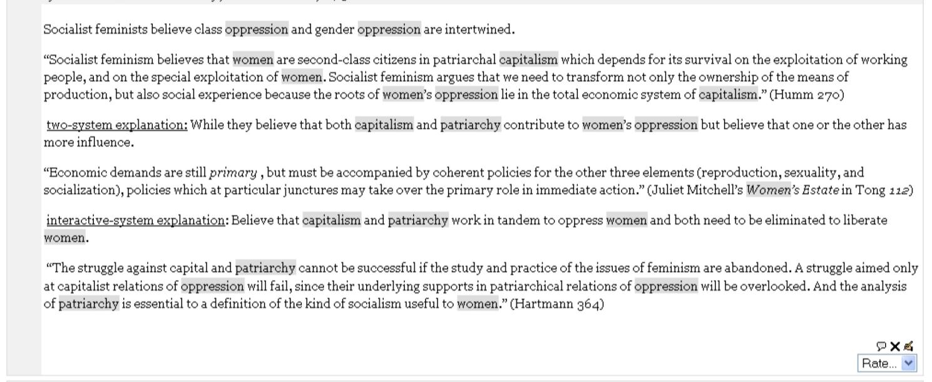
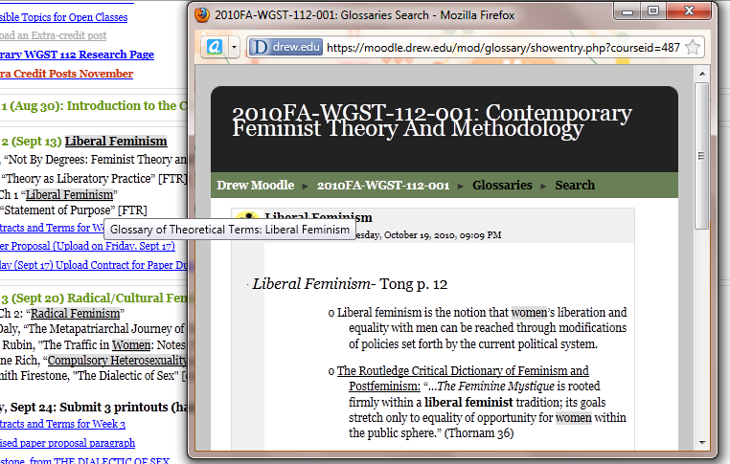
Course objective
From syllabus: “To master key terms and vocabulary from the field and to gain proficiency in the use of those terms.”
Importance of “Automatically link glossary entries” feature

Slide 45
Guidelines and Process
With some guidance, students select the terms - theoretical terms that are key to the author’s argument, not simply difficult standard vocabulary that can be looked up in a dictionary.
Find and cite a basic definition (based on feminist theory dictionaries and encyclopedias)
Quote an example or examples of the article author’s use of the term (be sure to include a page citation).
Post your glosses on discussion forum in Moodle by the Monday before we are discussing the relevant readings, so that students have your definitions while they read. Head your post:
“GLOSSES, [date of class], [topic of class]”, e.g. “Glosses, 9/25, Radical/Cultural Feminism”

Slide 46
First step: Moodle Forum
Initial posting in discussion forum, In class discussion, revision based on feedback, then post in glossary on Moodle.

Slide 47
Sample entry – Liberal Feminism

Slide 48
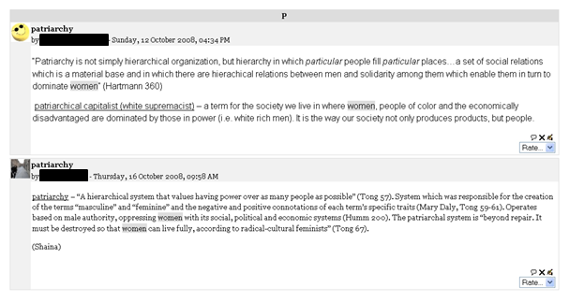
Sample Entry - Patriarchy

Slide 49
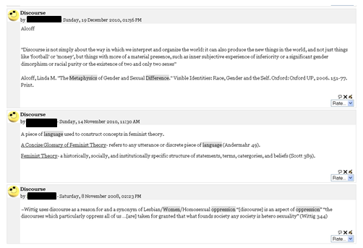
Sample Entry – Discourse

Slide 50
Moodle Wiki for Full Citations

Slide 51
Web Glossary
http://www.depts.drew.edu/wmst/CoreCourses/WMST112/WMST112_Glossary.htm#X

Slide 52
Thank You!
Questions? Comments? Suggestions?
Please also take advantage of the Moodle Course for this presentation for further interaction and collaboration.
You May Contact Us
Gamin Bartle, gbartle@drew.edu
Sarah Ashley, sashley1@drew.edu

